Slide 1
Patient Education Graphics
Created by:
James Hawkins, DDS, MS
Commander, Dental Corps, United States Navy
Chair, Orofacial Pain Center
Naval Postgraduate Dental School
Naval Medical Leader & Professional Development Command
Associate Professor
Uniformed Services University Postgraduate Dental College

Slide 2
Disclosures
Dr. James Hawkins, Dr. Istvan Hargitai, and Dr. Thomas Weber have no relevant financial or non-financial relationships to disclose relating to the content of this activity.
The views expressed in this presentation are those of the authors and do not necessarily reflect the official policy or position of the Department of Defense, the U.S. Government, or the Uniformed Services University of the Health Sciences.
This continuing education activity is managed and accredited by the Defense Health Agency, J-7, Continuing Education Program Office (DHA, J-7, CEPO). DHA, J-7, CEPO and all accrediting organizations do not support or endorse any product or service mentioned in this activity.
DHA, J-7, and CEPA staff, as well as activity planners and reviewers, have no relevant financial or non-financial interest to disclose.
Commercial support was not received for this activity.

Slide 3
DISCLOSURES
I am a military service member or federal/contracted employee of the United States government. This work was prepared as part of my official duties. Title 17 U.S.C. 105 provides that `copyright protection under this title is not available for any work of the United States Government.' Title 17 U.S.C. 101 defines a U.S. Government work as work prepared by a military service member or employee of the U.S. Government as part of that person's official duties.

Slide 4
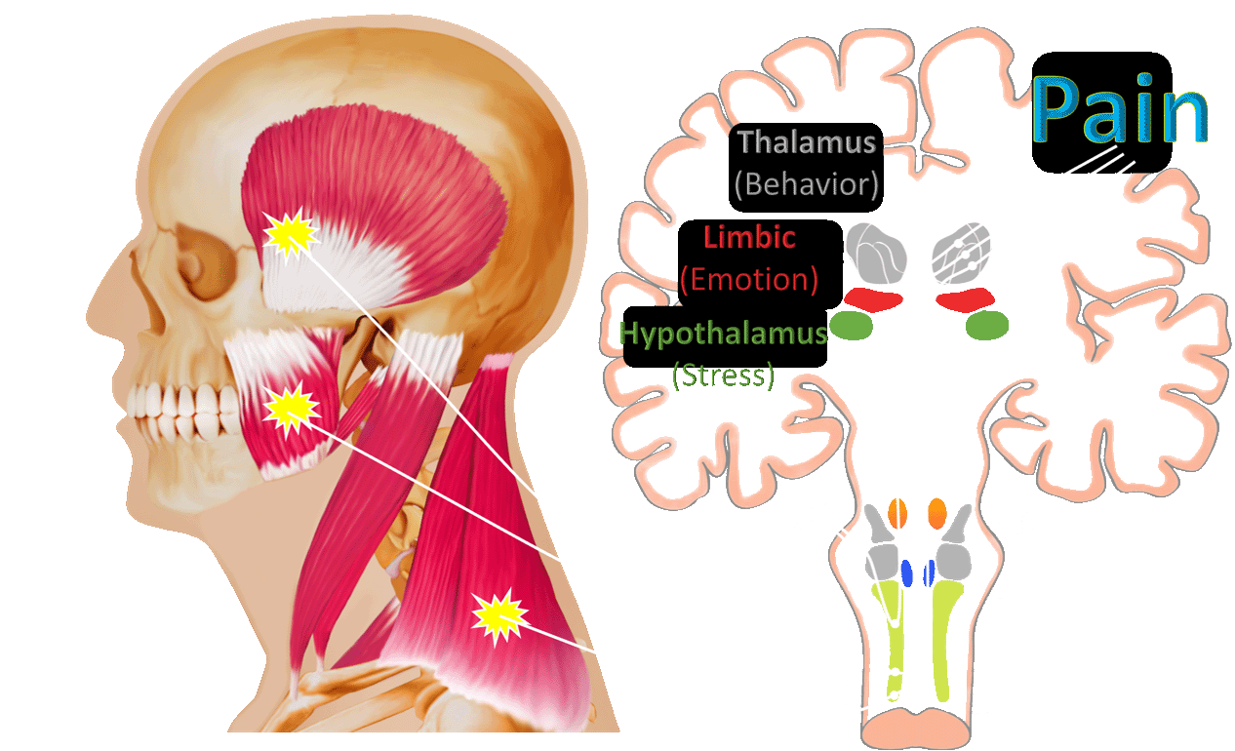
Author owned

Slide 5
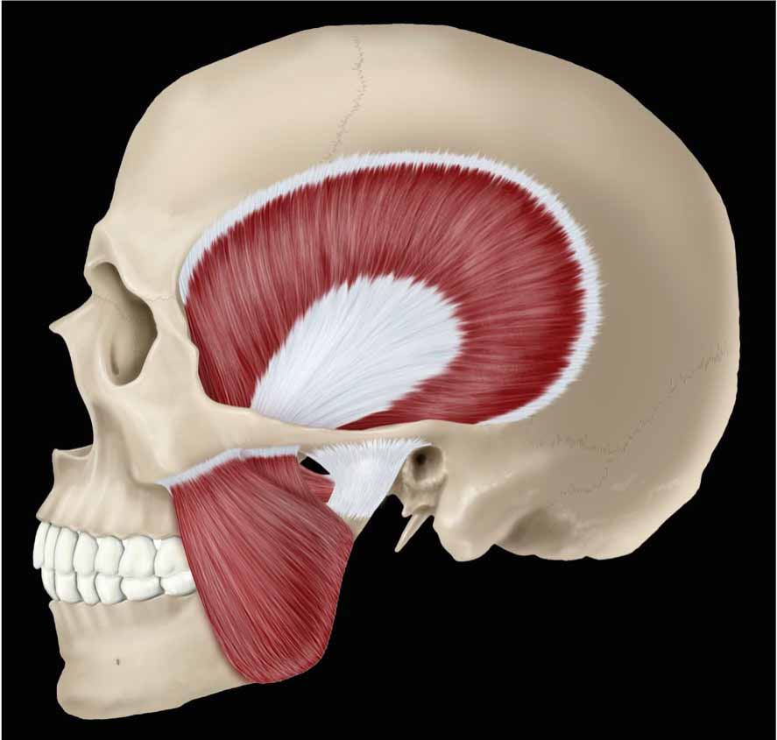
Masticatory Muscle Disorders
Image: Author owned

Slide 6
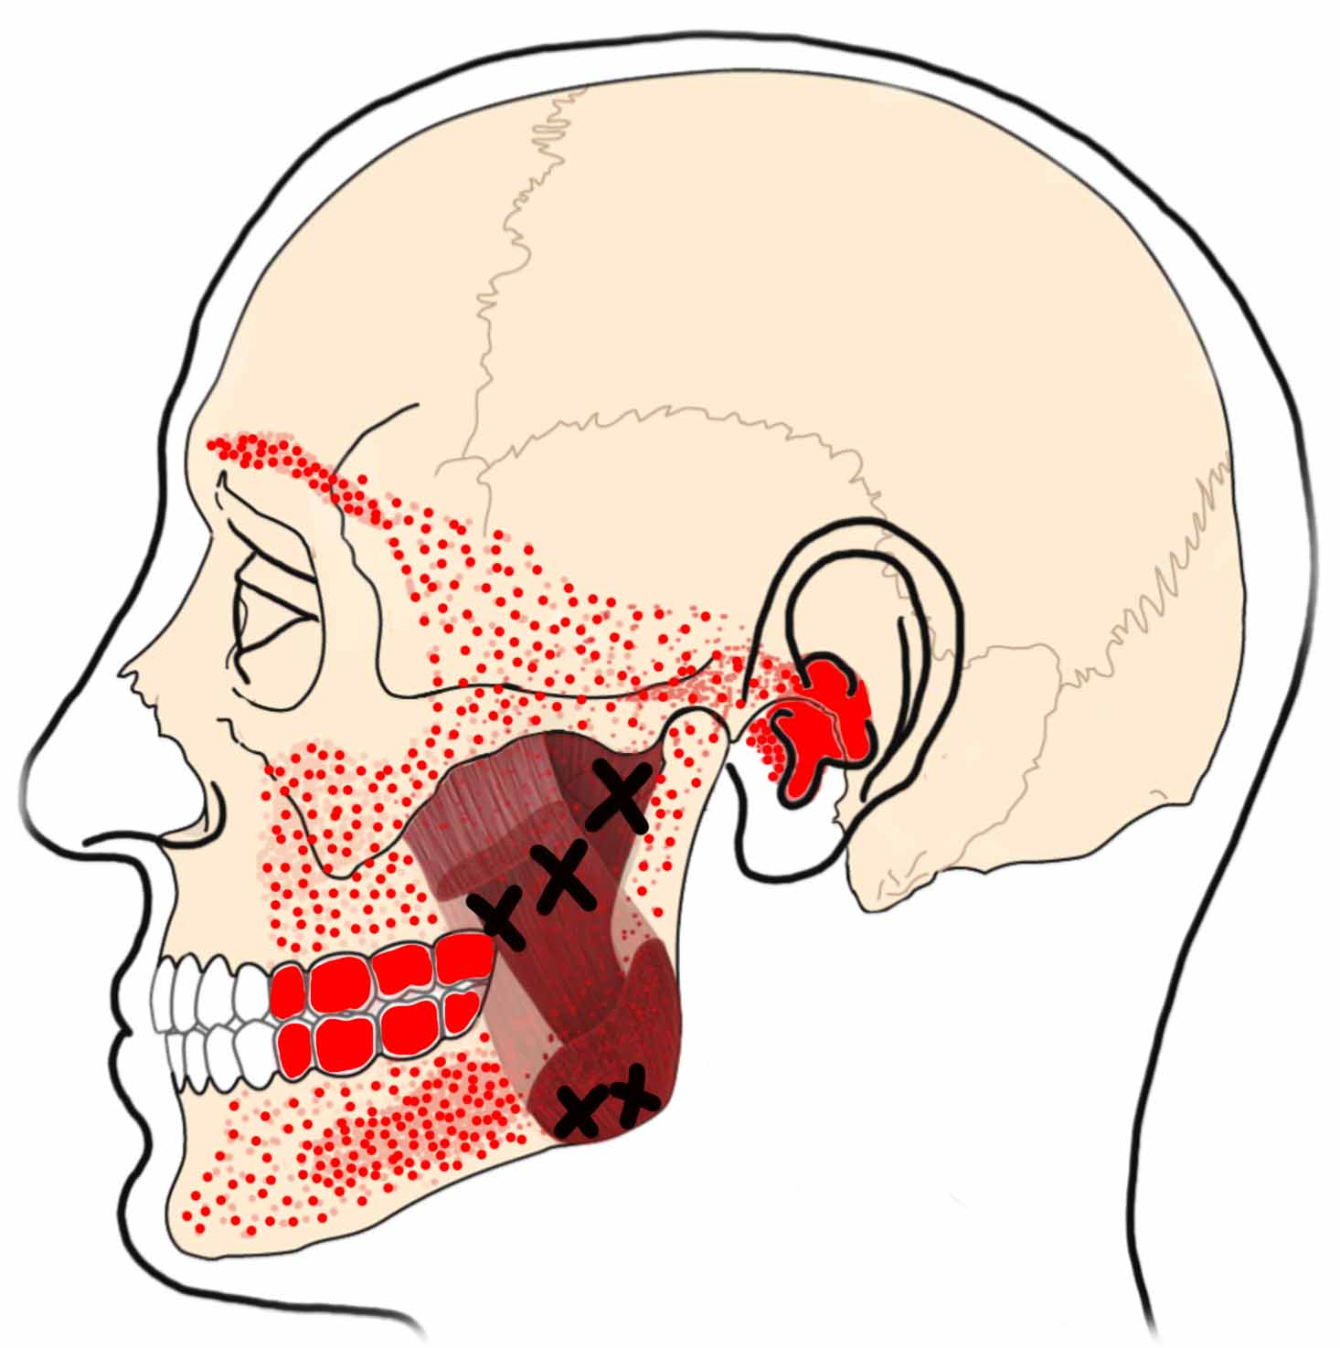
Masseter
Images: Author owned

Slide 7
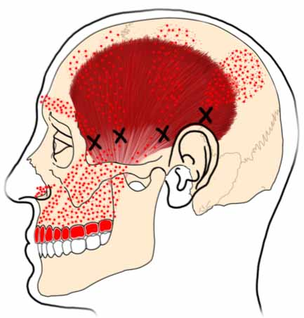
Temporalis
Images: Author owned

Slide 8
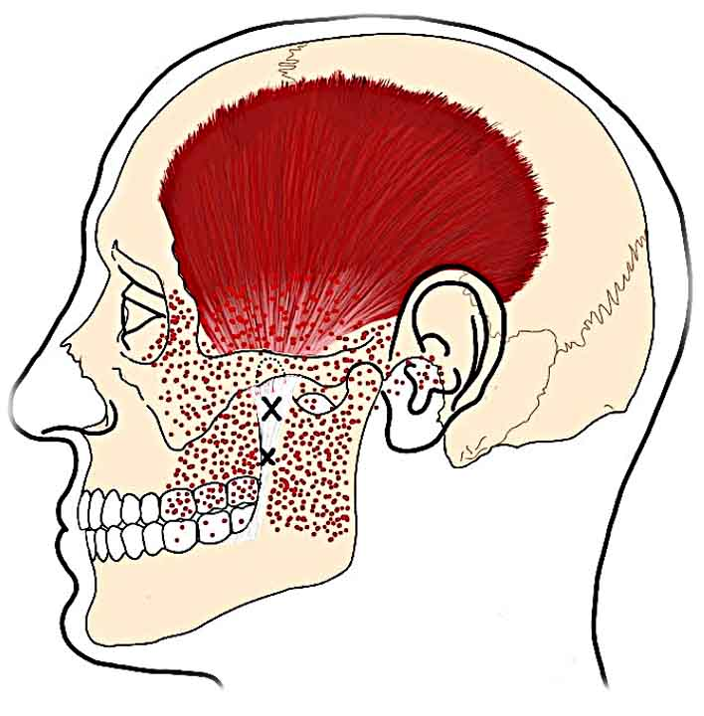
Temporal Tendon
Image: Author owned

Slide 9
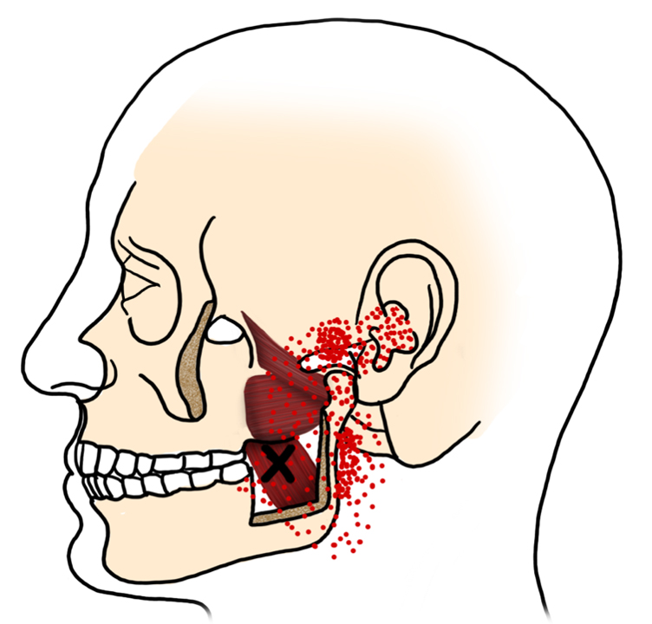
Medial Pterygoid
Image: Author owned

Slide 10
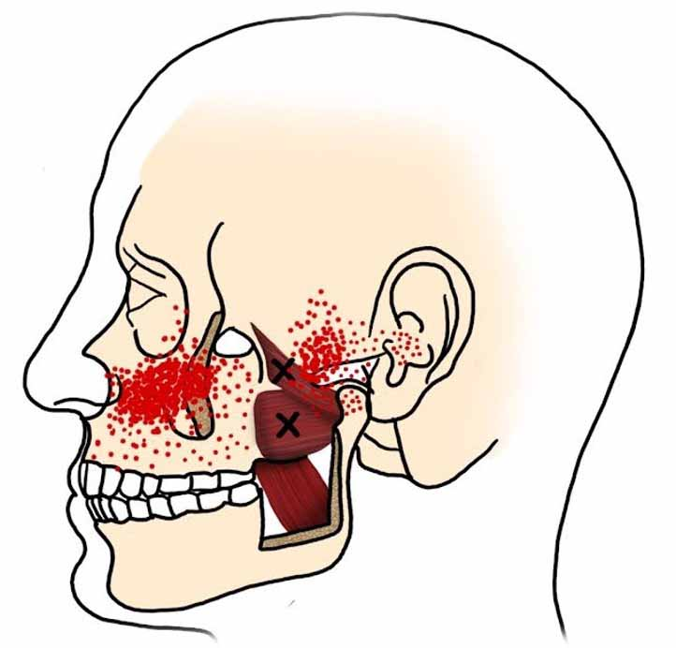
Lateral Pterygoid
Image: Author owned

Slide 11
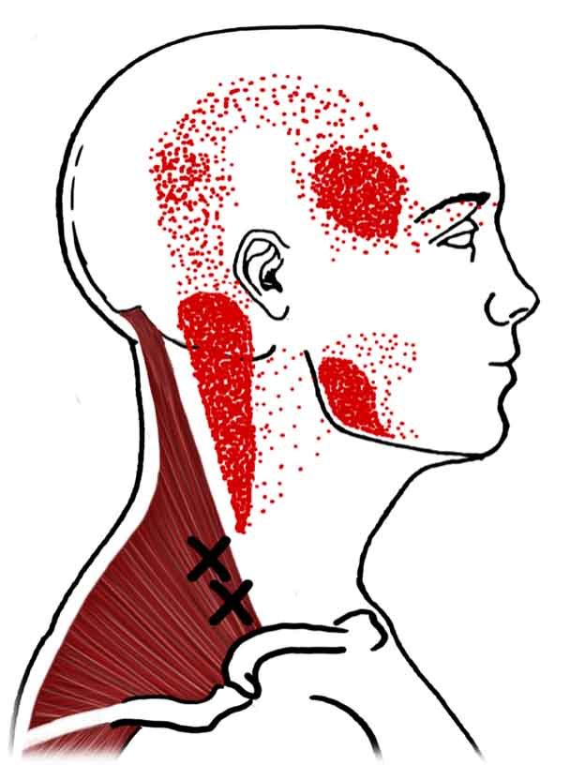
Trapezius

Slide 12
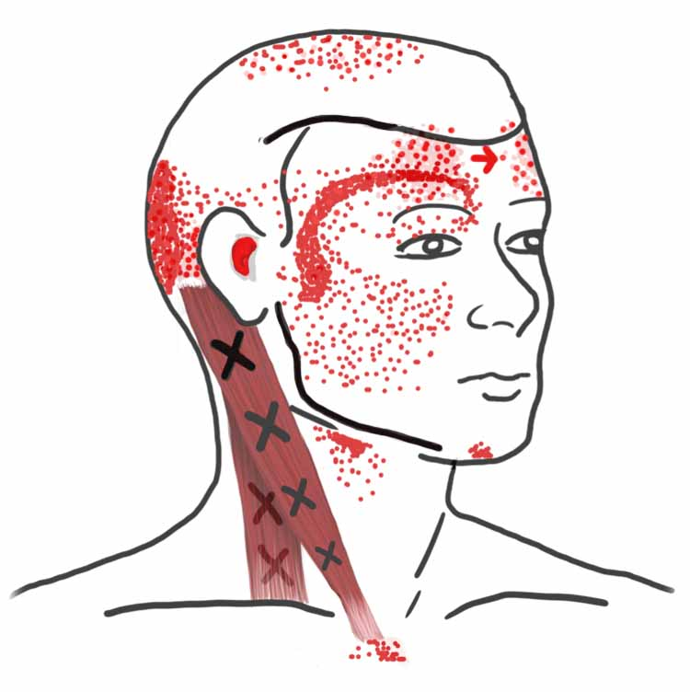
SCM

Slide 13
Temporomandibular Joint (TMJ)

Slide 14
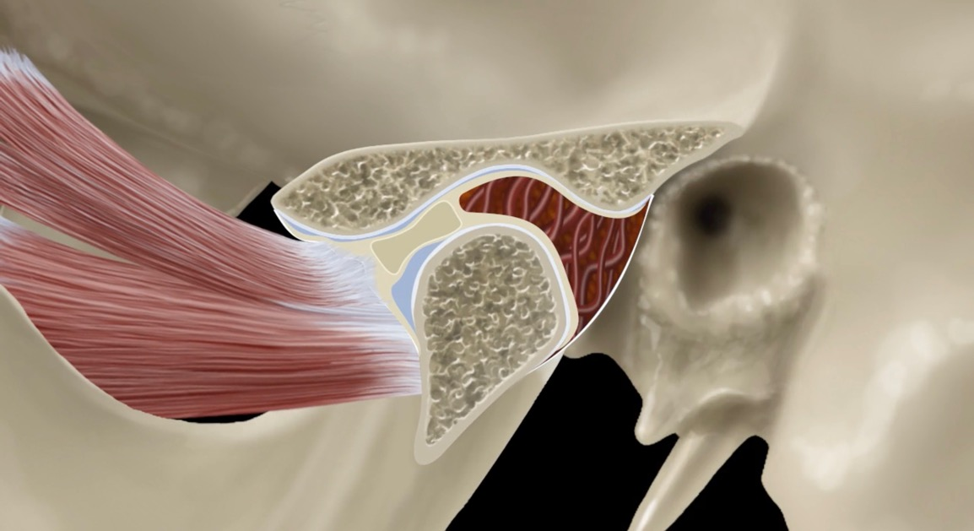
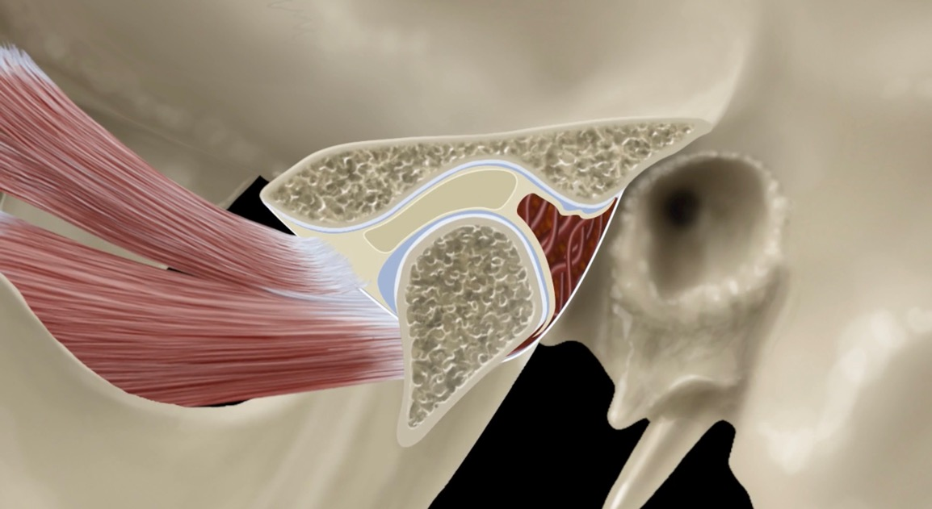
Disc Displacement

Slide 15
Disc Displacement
With Reduction

Slide 16
Disc Displacement
With Reduction
With
Intermittent
Locking

Slide 17
Disc Displacement
Without Reduction
With
Limited Opening

Slide 18
Disc Adaptation

Slide 19
Disc Displacement
Without Reduction
Without
Limited Opening

Slide 20
Degenerative Joint Disease
Nonpainful - Osteoarthrosis

Slide 21
Degenerative Joint Disease
Painful - Osteoarthritis

Slide 22
Subluxation / Luxation
Subluxation – Self reduced
Luxation – Clinician reduced

Slide 23
Comorbidities
Fatigue
Anxiety
Fibromyalgia
Pelvic Pain
Headache
TMD
IBS
Back Pain
PTSD
Depression

